Slide 1

Smart Library
An IoT System for Environmental Monitoring and Occupancy Analysis
Prepared by: - Moeez Ahmed and Mintesnot Nigusu YIMER

Slide 2
AGENDA
01
project Goal & Justification
05
Technologies Used
02
UN Sustainable Development Goals (SDGs)
06
System Architecture
03
Users and Their Stories
07
Ecodesign Evaluation
04
Project Management Approach
08
Opportunities for Improvement

Slide 3








The Need for a Smart Library
Research and real world evidence shows that environmental conditions strongly influence students’ learning experiences.
Lighting levels
Noise levels
Air quality
Space availability
Affect students’ mood and ability to stay focused.
Are one of the main factors students consider when choosing where to study.
Influence comfort and concentration. and also impacts productivity and overall comfort.
Plays a role in how effectively students can work.

Slide 4
Project Goal & Justification
Goal: To develop an IoT system that monitors environment and occupancy.
This system provides actionable insights for:
Improving User Comfort Ensure a pleasant and productive environment for all patrons.
Optimizing Space Make data-driven decisions about layout and resource allocation.
Reducing Energy Consumption Align HVAC and lighting with actual library usage to cut costs.

Slide 5


UN Sustainable Development Goals
Goal 11: Sustainable Cities
Goal 7: Affordable & Clean Energy
By making a public building like a library more efficient, safe, and comfortable, the project contributes to the sustainability of urban community infrastructure. It helps create smarter public spaces that respond to user needs.
The system provides the data necessary to reduce energy waste. By correlating occupancy with energy usage, the library can implement strategies (like automated lighting/HVAC) to lower consumption and improve energy efficiency.

Slide 6






Users and Their Stories
Library Administrator
Facility Manager
Students
"As a Facility Manager, I want to monitor temperature and air quality so that I can ensure a comfortable environment and perform proactive HVAC maintenance."
"As a student, I want to check how crowded the library is before I visit so that I can choose the best time to go and find a study space."
"As an Administrator, I want to see hourly and daily occupancy trends so that I can optimize staffing schedules and allocate resources."

Slide 7
Project Management Approach
A modular and iterative approach was used for solo development:
Task Breakdown Project was broken into key components: Data Collection, Communication, Storage, and Visualization.
Centralized Documentation A central file was maintained to document architecture, setup instructions, and development progress.
Simulation-First Development A simulation file was created to allow parallel development and testing of the backend without the physical hardware.

Slide 8
The Technology Stack
An overview of the hardware, software, and data flow.

Slide 9

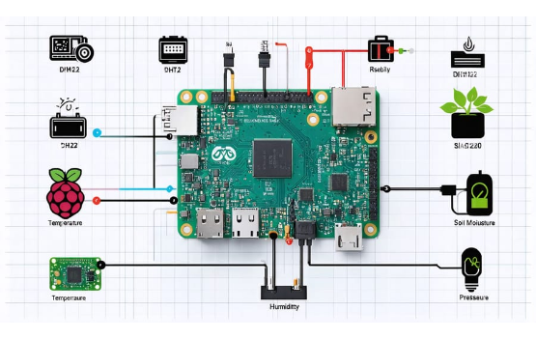
Technologies Used: Hardware
Raspberry Pi The central controller and brain of the operation, running the data collection script.
Arducam Camera Provides the video feed for person detection and calculating ambient light levels.
BME680 Sensor An all-in-one sensor that collects Temperature, Humidity, Pressure, and Air Quality (IAQ) data.

Slide 10
Technologies Used: Software
Python: Main language for data collection and simulation.
Docker & Docker Compose: For containerizing and orchestrating all backend services.
InfluxDB: Time-series database for efficiently storing all sensor data.
Grafana: For all data visualization and dashboarding.
Mosquitto (MQTT): Lightweight messaging protocol for IoT communication.
Telegraf: Agent for collecting, processing, and writing data to InfluxDB.

Slide 11


Technologies Used: Libraries & APIs
Key Libraries
Models & Queries
•
OpenCV (Python): For image processing (light level) and person detection.
•
Flux: Query language used in Grafana to retrieve and process data from InfluxDB.
•
Paho-MQTT (Python): Client library for connecting to the MQTT broker.
•
MobileNet-SSD: A pre-trained deep learning model optimized for running on low-power devices like a Raspberry Pi.
•
bme680 (Python): Library for interfacing with the BME680 sensor.

Slide 12








Software & Hardware Architecture
1. Collect
2. Communicate
3. Store
4. Visualize
pi_controller.py on the Raspberry Pi collects sensor data and detects people using the camera.
Telegraf subscribes to the MQTT topic, parses the JSON, and writes it into the InfluxDB database.
Grafana connects to InfluxDB as a data source and displays the data on a real-time dashboard.
The script publishes this data as a JSON payload to the Mosquitto MQTT broker.

Slide 13
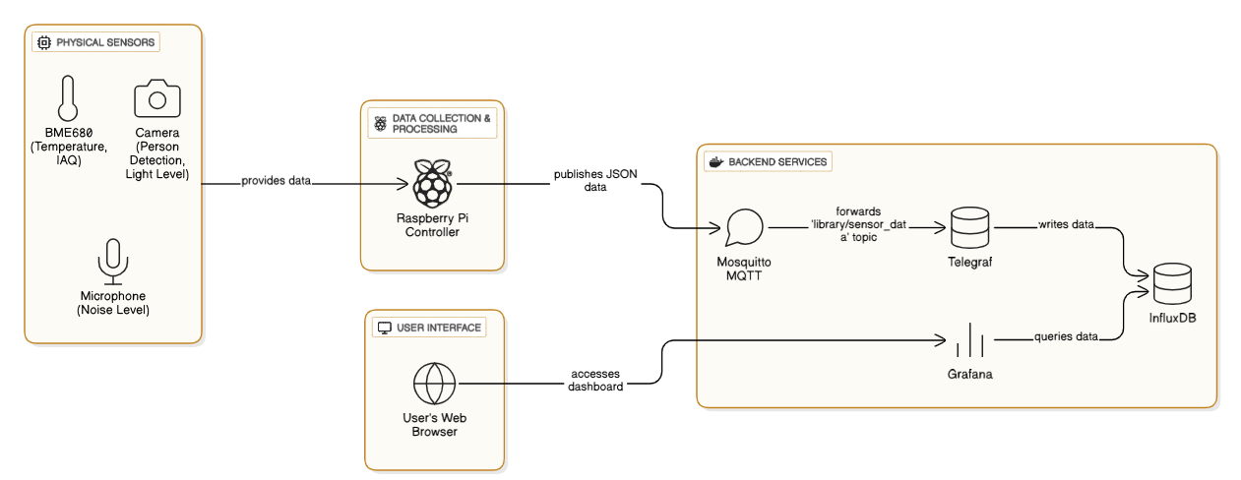
Software & Hardware Architecture

Slide 14

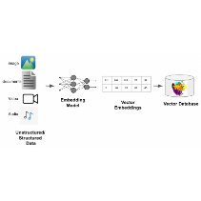
Database Architecture (InfluxDB)
Measurement: Sensor Readings
Tags (for indexing): location (e.g., "library_zone_A") sensor_id (e.g., "pi_controller_01")
Fields (the actual values): people_count (integer) temperature (float) iaq (float),
light_level (float), noise_db (float)

Slide 15


Environmental Impact
Positive Impact
Negative Impact
Energy Reduction: Provides the data needed to intelligently control lighting and HVAC systems based on actual occupancy and environmental conditions.
E-Waste: The project introduces electronic hardware (Raspberry Pi, sensors) which has a limited lifespan and will eventually become electronic waste.
Energy Consumption: The Raspberry Pi and the server running the backend services consume electricity. While low-power, the cumulative effect is non-zero.
Resource Optimization: Better management of library spaces and staff leads to more efficient use of existing resources.

Slide 16
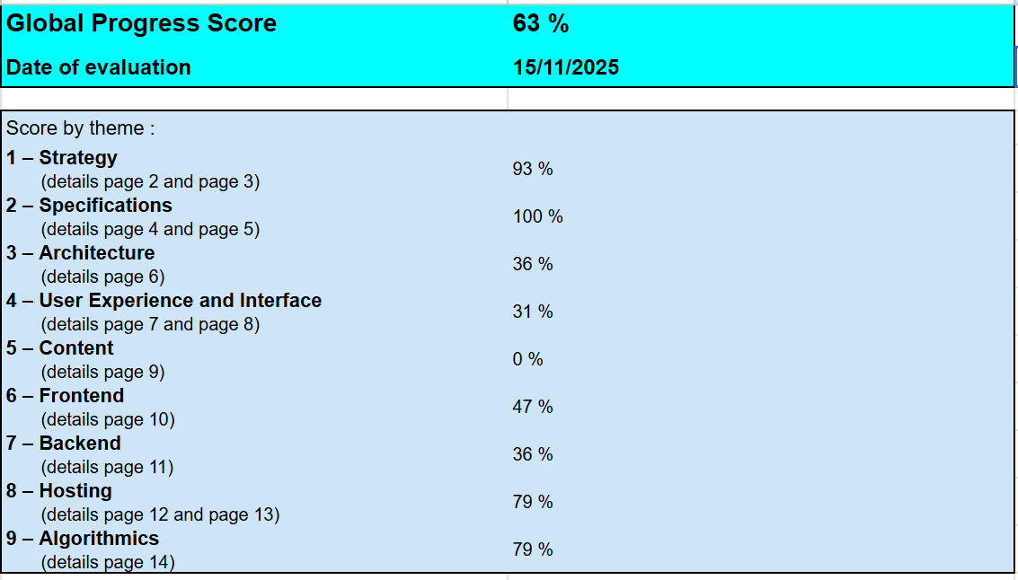
Ecodesign Evaluation (RGESN)

Slide 17

Main Compliant Criteria (Our Strengths)
High Utility & Strategy
Hardware Compatibility
The dashboard meets a validated user need (finding study space) without superfluous features, avoiding digital waste.
The service works on older devices and low-speed connections thanks to its lightweight architecture and standard web technologies.
Data Responsibility
Open Source Stack
We collect only essential signals (occupancy counts), avoiding personal tracking, facial recognition, or metadata.
Built entirely on open-source technologies (InfluxDB, Grafana, Mosquitto), ensuring transparency, longevity, and no vendor lock-in.
Frugal User Interface
Efficient Storage Strategy
The design avoids "heavy" media—no autoplay videos, no infinite scrolling, and no complex animations.
We use a Time-Series Database (TSDB) which compresses sensor data far more efficiently than traditional relational databases.

Slide 18
Main Non-Compliant Criteria (Roadmap)
Data Lifecycle
UX Enhancements
We must configure strict Retention Policies in InfluxDB to automatically delete raw sensor data older than 30 days to prevent disk bloat.
Implement a "Viability Score" or similar single metric to simplify decision-making for users and reduce analysis paralysis when selecting a study area.
.
Protocol Optimization
Energy Monitoring
Currently sending JSON text over MQTT. Switching to a binary format (like Protobuf) would reduce payload size for network communication.
We lack hardware tools (like smart plugs) to measure the actual real-time power consumption of the Raspberry Pi.
Impact Documentation
We need to formally calculate and document the energy ROI: Does the energy saved by students finding seats outweigh the server's run cost?

Slide 19


Opportunities for Improvement
Short / Mid-Term
Long-Term
•
Implement Smart Controls: Integrate with smart plugs or building APIs to automatically dim lights or adjust the thermostat.
•
Sustainable Hardware Sourcing: When scaling, choose hardware from manufacturers with strong environmental commitments.
•
Optimize Data Collection: Make the collection frequency dynamic (e.g., publish data less frequently).
•
Dynamic Forecasting: Develop advanced predictive models to forecast space utilization beforehand.
•
Event-Driven Detection: Run the person detection model only when motion is first detected.
•
Holistic Lifecycle Management: Develop a plan for device repairs, upgrades, and responsible recycling.

Slide 20
REFERENCES
theCha, S., & Kim, T.-W. (2015). What matters for students' use of physical library space? The Journal of Academic Librarianship, 41(3), 274–279. https://doi.org/10.1016/j.acalib.2015.03.014
Peng, L., Wei, W., Fan, W., Jin, S., & Liu, Y. (2022). Student Experience and Satisfaction in Academic Libraries: A Comparative Study among Three Universities in Wuhan. Buildings, 12(5), 682. https://doi.org/10.3390/buildings12050682

Slide 21
Questions?
Thank you for your attention.

